Slide 1

APT 3010 A Artificial Intelligence
.
Semester: Fall 2022.
||Fredrick Michael Ogore||fogore@usiu.ac.ke||Cell-No:0717105568||
1

Slide 2
Fuzzy Logic
The term fuzzy refers to things that are not clear or are vague.
In the real world many times we encounter a situation when we can’t determine whether the state is true or false, their fuzzy logic provides very valuable flexibility for reasoning.
In this way, we can consider the inaccuracies and uncertainties of any situation.

Slide 3
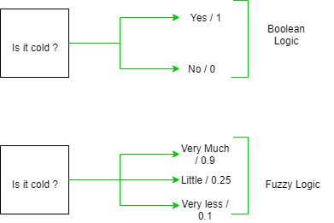
Fuzzy Logic

Slide 4
Fuzzy Logic

Slide 5
Fuzzy Logic
What is Fuzzy Logic?
Fuzzy Logic (FL) is a method of reasoning that resembles human reasoning.
The approach of FL imitates the way of decision making in humans that involves all intermediate possibilities between digital values YES and NO.
The conventional logic block that a computer can understand takes precise input and produces a definite output as TRUE or FALSE, which is equivalent to human’s YES or NO.

Slide 6
Fuzzy Logic
Fuzzy logic is used in Natural language processing and various intensive applications in Artificial Intelligence.
It is extensively used in modern control systems such as expert systems.
Fuzzy Logic mimics how a person would make decisions, only much faster.
Fuzzy Logic Systems (FLS) produce acceptable but definite output in response to incomplete, ambiguous, distorted, or inaccurate (fuzzy) input.

Slide 7

Fuzzy Logic
The inventor of fuzzy logic, Lotfi Zadeh, observed that unlike computers, the human decision making includes a range of possibilities between YES and NO, such as
The fuzzy logic works on the levels of possibilities of input to achieve the definite output.

Slide 8
Implementation.
It can be implemented in systems with various sizes and capabilities ranging from small micro-controllers to large, networked, workstation-based control systems.
It can be implemented in hardware, software, or a combination of both.

Slide 9
What is Fuzzy Control?
It is a technique to embody human-like thinkings into a control system.
It may not be designed to give accurate reasoning but it is designed to give acceptable reasoning.
It can emulate human deductive thinking, that is, the process people use to infer conclusions from what they know.
Any uncertainties can be easily dealt with the help of fuzzy logic.

Slide 10
Why Fuzzy Logic?
Fuzzy logic is useful for commercial and practical purposes.
It can control machines and consumer products.
It may not give accurate reasoning, but acceptable reasoning.
Fuzzy logic helps to deal with the uncertainty in engineering.

Slide 11
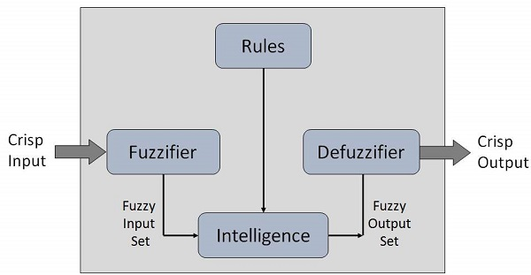
Fuzzy Logic Systems Architecture

Slide 12
Fuzzy Logic Systems Architecture
Fuzzification Module − It transforms the system inputs, which are crisp numbers, into fuzzy sets. It splits the input signal into five steps such as −
Knowledge Base − It stores IF-THEN rules provided by experts.
Inference Engine − It simulates the human reasoning process by making fuzzy inference on the inputs and IF-THEN rules.
Defuzzification Module − It transforms the fuzzy set obtained by the inference engine into a crisp value.

Slide 13
Fuzzy Logic Systems Architecture
Fuzzification Module − It transforms the system inputs, which are crisp numbers, into fuzzy sets. It splits the input signal into five steps such as −
LP | x is Large Positive
MP | x is Medium Positive
S | x is Small
MN | x is Medium Negative
LN | x is Large Negative

Slide 14
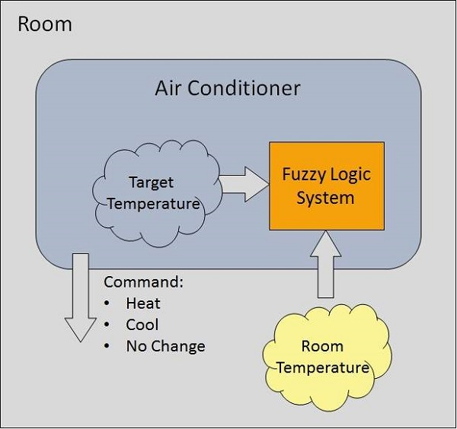
Example of a Fuzzy Logic System
Let us consider an air conditioning system with 5-level fuzzy logic system.
This system adjusts the temperature of air conditioner by comparing the room temperature and the target temperature value.

Slide 15
Advantages of Fuzzy Logic System
This system can work with any type of inputs whether it is imprecise, distorted or noisy input information.
The construction of Fuzzy Logic Systems is easy and understandable.
Fuzzy logic comes with mathematical concepts of set theory and the reasoning of that is quite simple.
It provides a very efficient solution to complex problems in all fields of life as it resembles human reasoning and decision-making.
The algorithms can be described with little data, so little memory is required.

Slide 16
Disadvantages of Fuzzy Logic System
Many researchers proposed different ways to solve a given problem through fuzzy logic which leads to ambiguity. There is no systematic approach to solve a given problem through fuzzy logic.
Proof of its characteristics is difficult or impossible in most cases because every time we do not get a mathematical description of our approach.
As fuzzy logic works on precise as well as imprecise data so most of the time accuracy is compromised.

Slide 17
Application Areas of Fuzzy Logic
The key application areas of fuzzy logic are as given −
Automotive Systems
Automatic Gearboxes
Four-Wheel Steering
Vehicle environment control
Consumer Electronic Goods
Hi-Fi Systems
Photocopiers
Still and Video Cameras
Television

Slide 18
Application Areas of Fuzzy Logic
The key application areas of fuzzy logic are as given −
Domestic Goods
Microwave Ovens
Refrigerators
Toasters
Vacuum Cleaners
Washing Machines
Environment Control
Air Conditioners/Dryers/Heaters
Humidifiers

